Slide 1
An Efficient Methodology for Mapping Quantum Circuits to QX Architecture
Bhuvanesh S K
(4NM16EC026)
Department of
Electronics & Communication Engineering

Slide 2
Contents
Introduction to Quantum computing it's need in modern world.
Introduction to qubits and it's implementation techniques.
Quantum circuits and types in QISKIT
Quantum Error correction and possible solutions.
Examples of few Q-Circuits and it's optimizations
Conclusion
Department of ECE
0

Slide 3
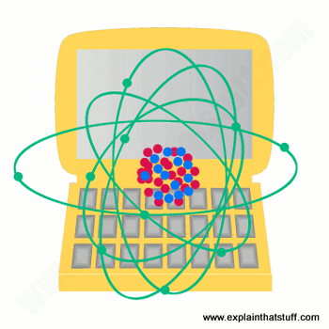
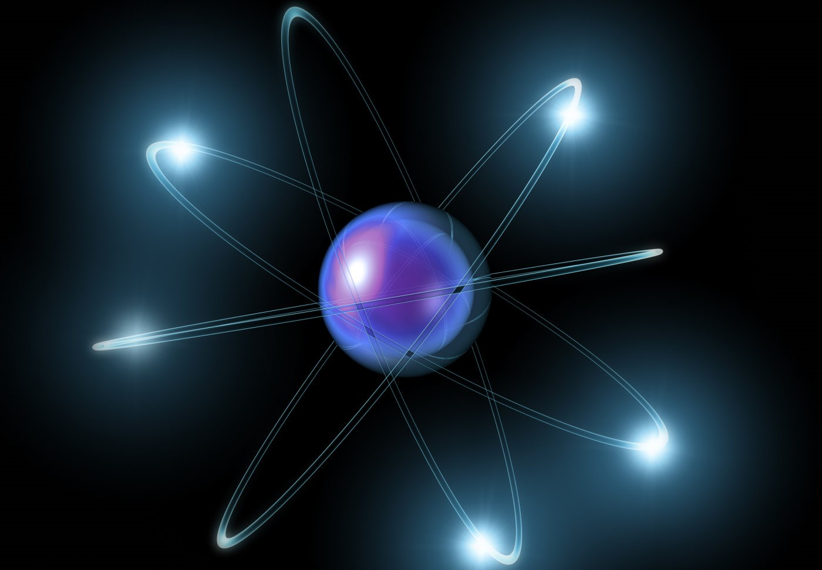
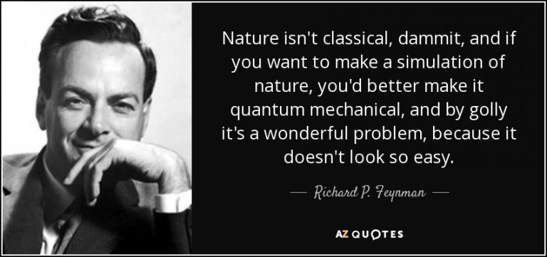
Introduction to Quantum computing it's need in modern world
Department of ECE
0

Slide 4
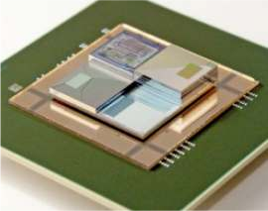
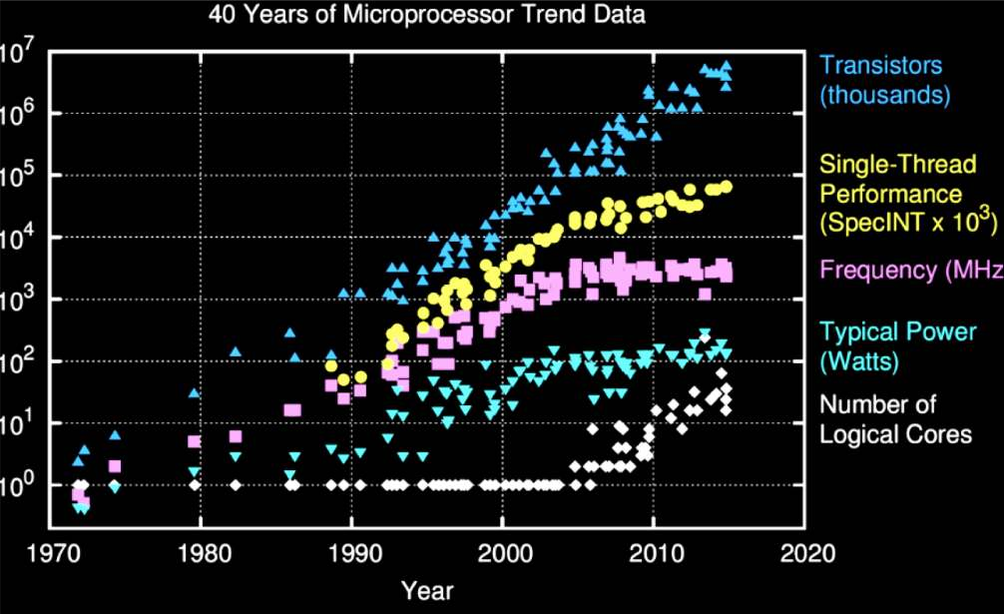
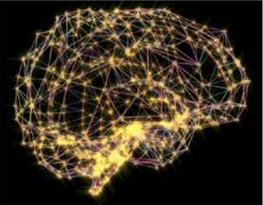


Introduction to Quantum computing it's need in modern world
More computational power...!
Efficient way to over come Morse law.
2014
First integrated circuit Size ~1cm²
2 Transistors
Moore’s Law is Born Intel 4004
2,300 transistors
(3D/hybrid)
neuromorphic
(cognitive)
quantum computing
Department of ECE
0
Ivano Tavernelli - ita@zurich.ibm.com

Slide 5
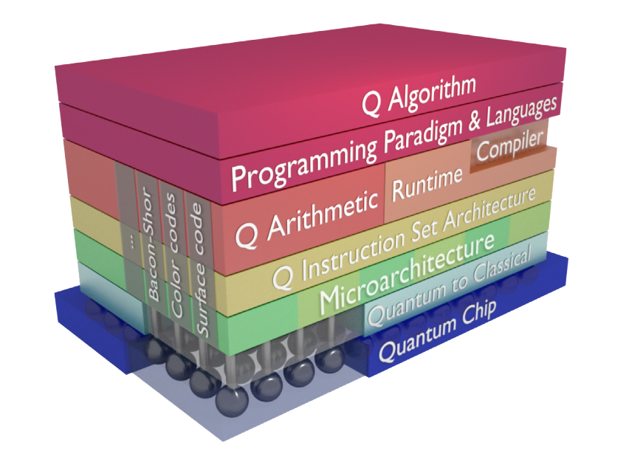
Introduction to Quantum computing it's need in modern world
Full Stack implementation
Department of ECE
0

Slide 6
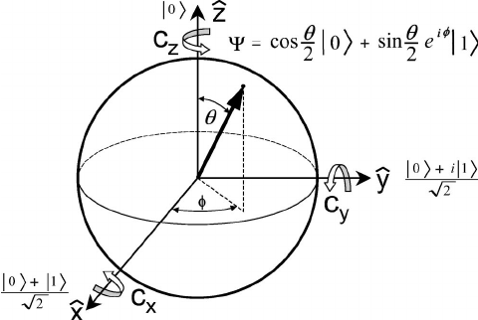
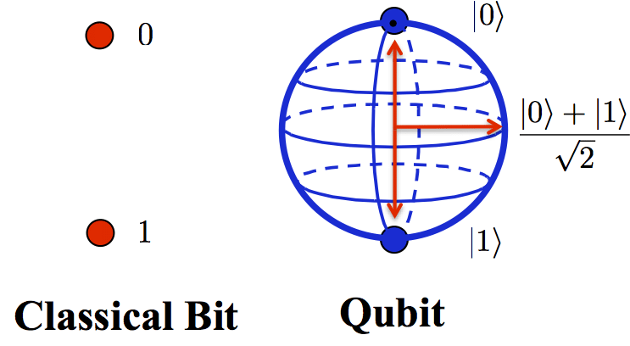
Introduction to qubits and it's implementation techniques.
2014
More computational power...!
Efficient way to over come Morse law.
It's described in Hilbert Space.
Moore’s Law is Born Intel 4004
2,300 transistors
Department of ECE
0
Ivano Tavernelli - ita@zurich.ibm.com

Slide 7
Introduction to qubits and it's implementation techniques.
|ψ1⟩=(1/√2)(|0⟩+|1⟩) , |ψ2⟩=(1/√2)(|0⟩+|1⟩) are 2 qubits q1 and q2 respectively. Then product of q1 and q2 ,
|ψ⟩=|ψ1⟩⊗|ψ2⟩which is (1/2)(|00⟩+|01⟩+|10⟩+|11⟩) has
2^{N} (= 4) states.
They are linear
⟨C|{|A⟩+|B⟩} = ⟨C|A⟩+ ⟨C|B⟩
They have complex conjugate
⟨B|A⟩= ⟨A|B⟩*
|A⟩+ |B⟩= ⟨A| + ⟨B|
z|A⟩= ⟨A|z*
Department of ECE
0

Slide 8
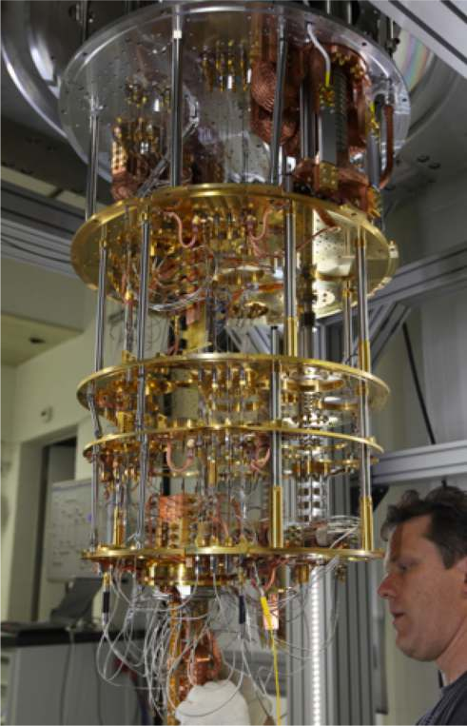
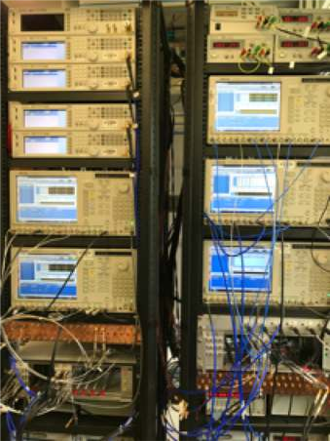
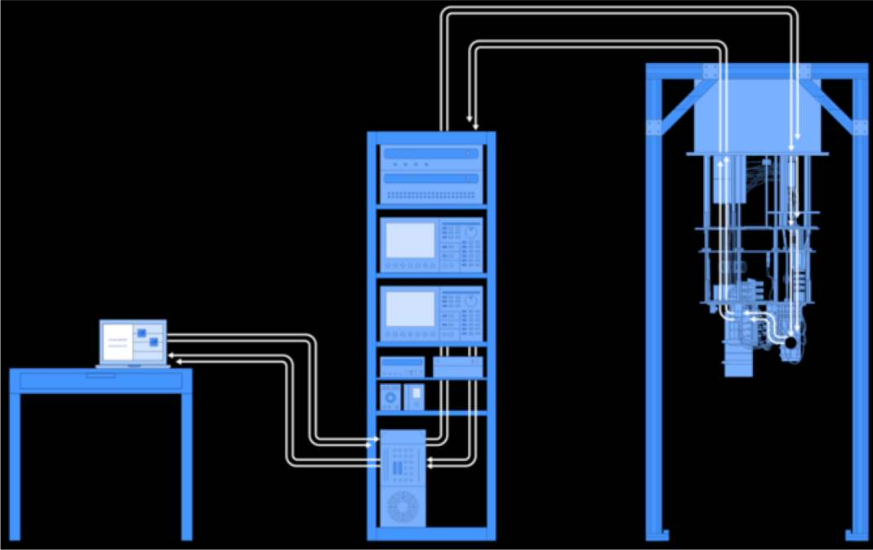

Introduction to qubits and it's implementation techniques.
40K
Refrigerator to cool qubits to 10 - 15 mK with a mixture of ³He and ⁴He
Microwave electronics
3K
0.9K
0.1K
.015K
Department of ECE
0

Slide 9
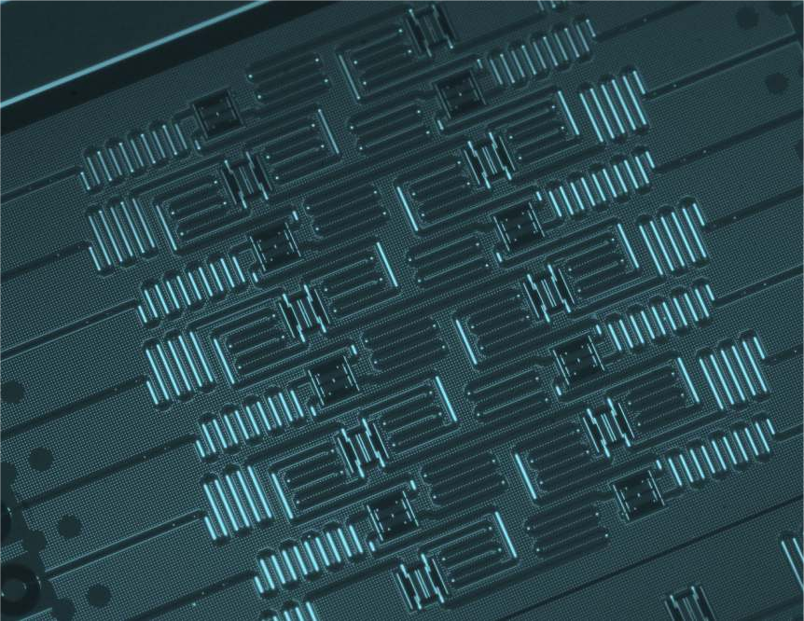
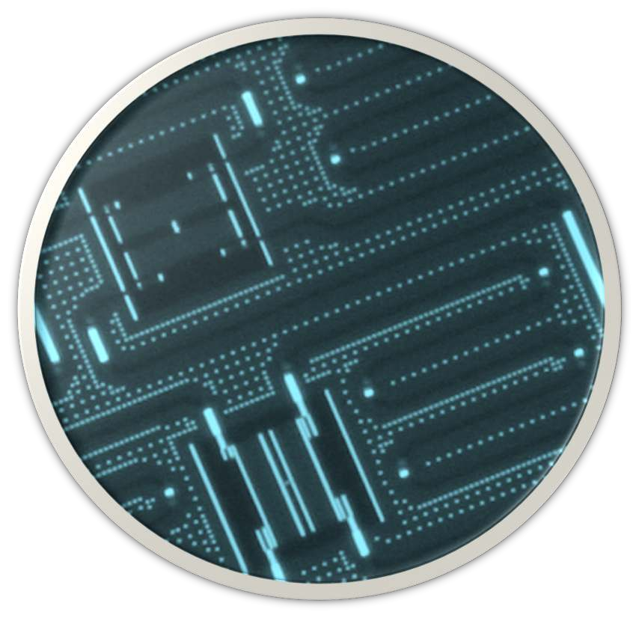
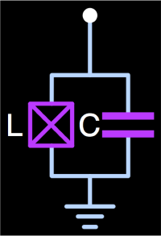
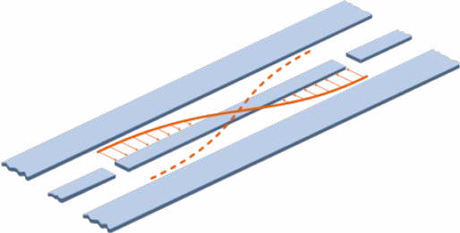
Introduction to qubits and it's implementation techniques.
Superconducting qubit (transmon):
quantum information carrier
nearly dissipationless →
T₁, T₂ ~ 70 µs lifetime, 50MHz clock speed
Microwave resonator as:
read-out of qubit states
quantum bus
noise filter
Department of ECE
0

Slide 10
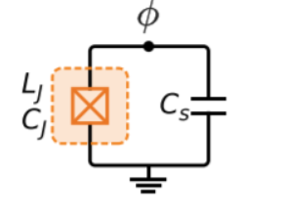
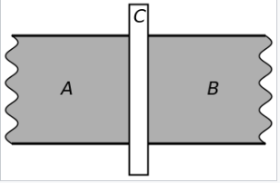
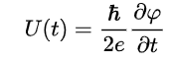
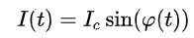
Introduction to qubits and it's implementation techniques.
IBM QX Architectures uses superconducting
quantum computing.
Transmon is a type of superconducting charge qubit that was designed to have reduced sensitivity to charge noise.
Its makes use of Josephson Effect
(superconducting phase evolution equation)
(Josephson or weak-link current-phase relation)
Department of ECE
0

Slide 11
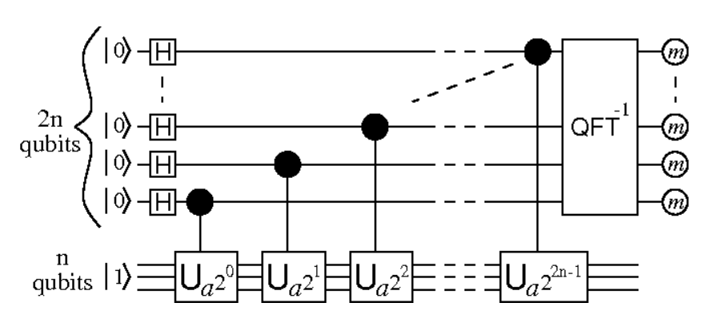
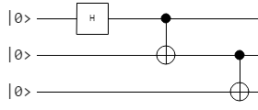
Quantum circuits and types in QISKIT.
What are Quantum circuits??
Model for quantum computation in which a computation is a sequence of quantum gates, which are reversible transformations on a quantum mechanical analog of an n-bit register. This analogous structure is referred to as an n-qubit register.
Here are 2 Examples.....
1.) 2.)
Department of ECE
0

Slide 12

Quantum circuits and types in QISKIT.
Department of ECE
0

Slide 13
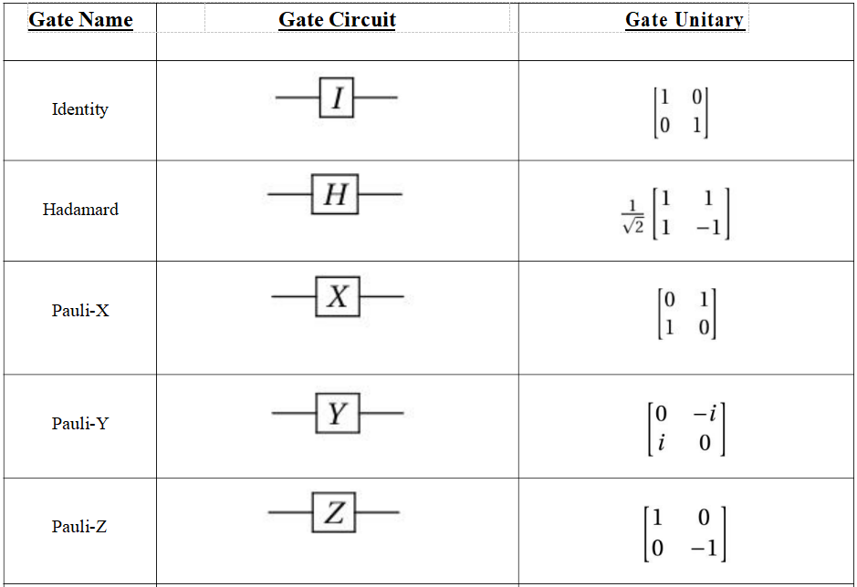
Quantum circuits and types in QISKIT.
Department of ECE
0

Slide 14
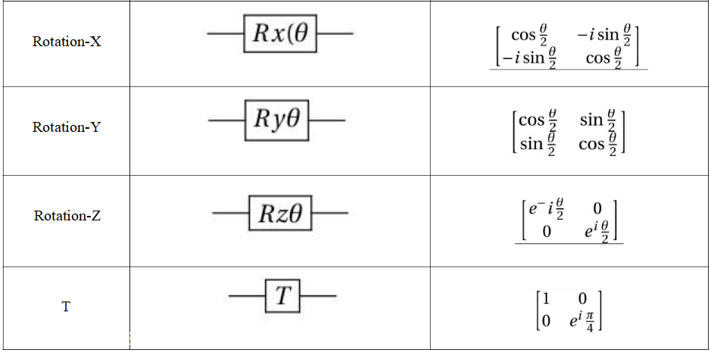
Quantum circuits and types in QISKIT.
Department of ECE
0

Slide 15
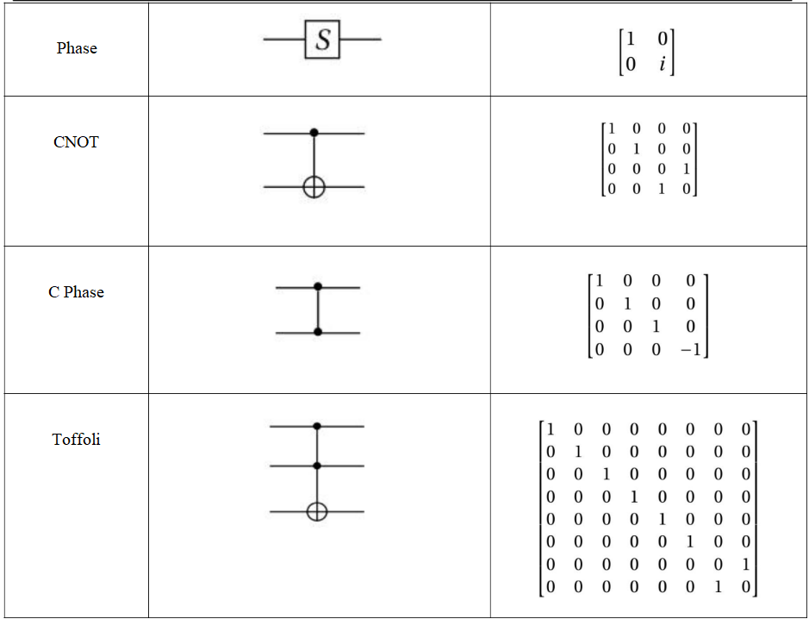
Quantum circuits and types in QISKIT.
Department of ECE
0

Slide 16
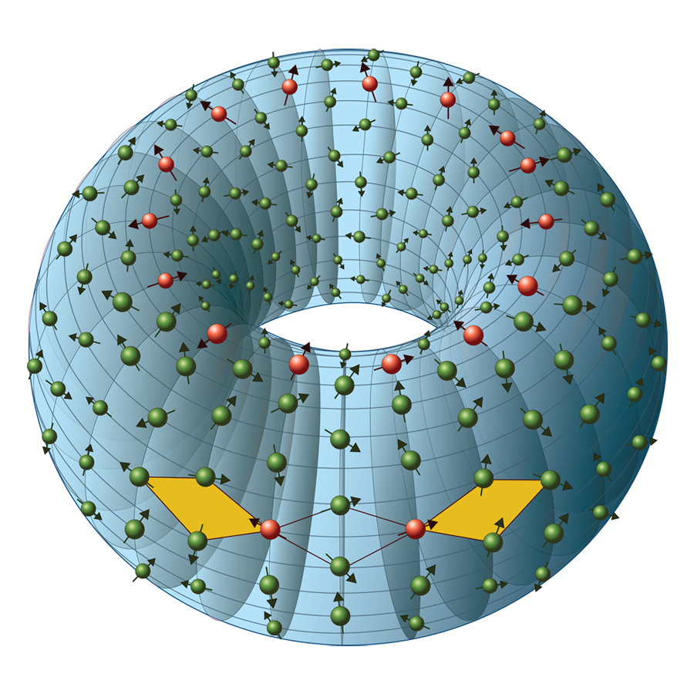
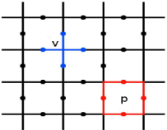
Quantum Error correction and possible solutions.
1.) Repeating the qubits like α |0⟩+ β |1⟩can be saved as 3*(α |0⟩+ β |1⟩).
2.) In Redundancy, qubits are entangled instead of coping. This qubit state is called Bell’s State. For example, α |0⟩+ β |1⟩can be represented as α |000⟩+ β |111⟩.
3.) The toric code is defined on a
two-dimensional lattice, usually
chosen to be the square lattice,
with a spin-½ degree of freedom
located on each edge. They are
chosen to be periodic. Stabilizer
operators are defined on the spins
around each vertex and plaquette
(or face i.e. a vertex of the dual
lattice) of the lattice.
Department of ECE
0

Slide 17
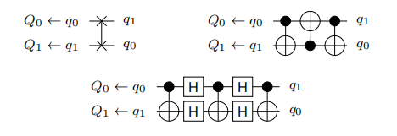
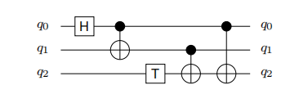
Examples of few Q-Circuits and it's optimizations
Example 1 :- Consists of 3 qubits, y. First, a Hadamard operation is applied to qubit q0. Then, a CNOT operation with target q1 and control qubit q0 is conducted followed by a T-gate that is applied to q2. Finally, two more CNOTs are applied.
Example 2:- SWAP operation operates on 2 qubits ,say q1 and q0. It’s implemented using 3 CNOTs and Hadamard gate which is U(π/2, 0, π). Hadamard gate is used to represent inverted CNOT in terms of CNOT gate.
Eg-2:
Eg-1:
Department of ECE
0

Slide 18
Examples of few Q-Circuits and it's optimizations
Example 3 & 4:- The logical qubits q0, q1, q2, q3, q4, and q5 are respectively mapped to the physical qubits Q0, Q1, Q2, Q3, Q14, and Q15 of the IBM QX3 architecture. The first gate can directly be applied, because the CNOT constraint is satisfied. For the second gate, the direction has to be changed because a CNOT with control qubit Q0 and target Q1 is valid, but not vice versa. This can be accomplished by inserting Hadamard gates for Q0 and Q1 either side of CNOT. For the third gate, changing the mapping. To this end, we insert SWAP operations SWAP(Q1, Q2) and SWAP(Q2, Q3) to move logical qubit towards logical qubit q4. Afterwards, q1 and q4 are mapped to the physical qubits Q3 and Q14, respectively, which allows us to apply the desired CNOT gate.
Department of ECE
0

Slide 19
Examples of few Q-Circuits and it's optimizations
Example 5:- The Quantum circuit from Example 3 considered again. The gates of the circuit can be partitioned into three layers l₀ = {g₀, g₁}, l₁ = {g₂, g₃}, and l₂ = {g₄}. To satisfy all CNOT constraints, mapping the logical qubits of each layer li to physical ones. Since the resulting mapping for layer li does not necessarily have to be equal to the mapping determined for the previous layer li-1,Additionally to insert SWAP operations that permute the logical qubits from the mapping for layer li-1 to the desired mapping for layer li. So basically it’s partitioning the circuit into layers.
Department of ECE
0

Slide 20
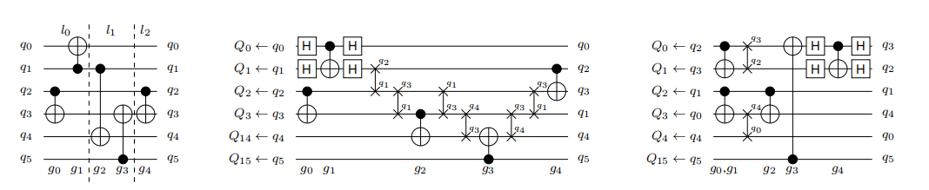
Examples of few Q-Circuits and it's optimizations
Example 3,4 &5
Department of ECE
0

Slide 21
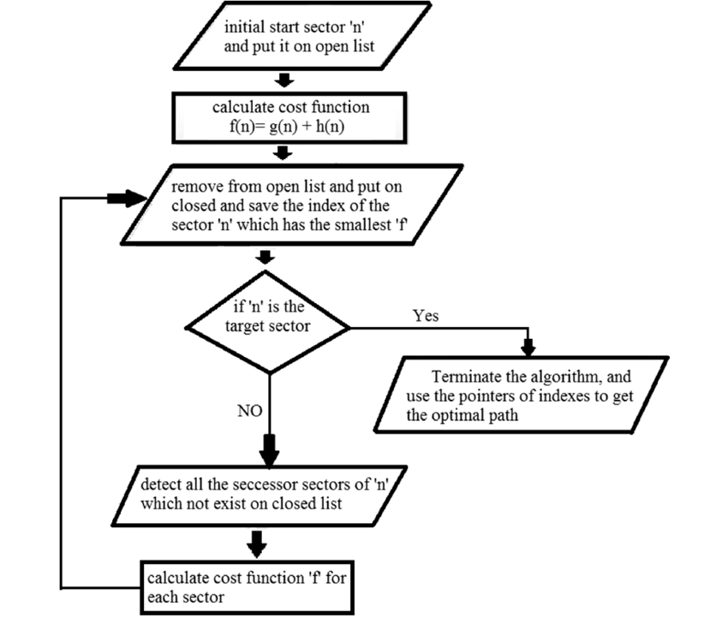
Examples of few Q-Circuits and it's optimizations
Examples 6,7,8 and 9 uses A* heuristic search algorithm
f(x) = g(x) + h(x) of a hub x. The initial segment (g(x)) portrays the expense of the present sub-arrangement (for example the expense of the way from the root to x). The subsequent part depicts the rest of the expense (for example the expense from x to an objective hub), which is evaluated by a heuristic capacity h(x).
Department of ECE
0

Slide 22
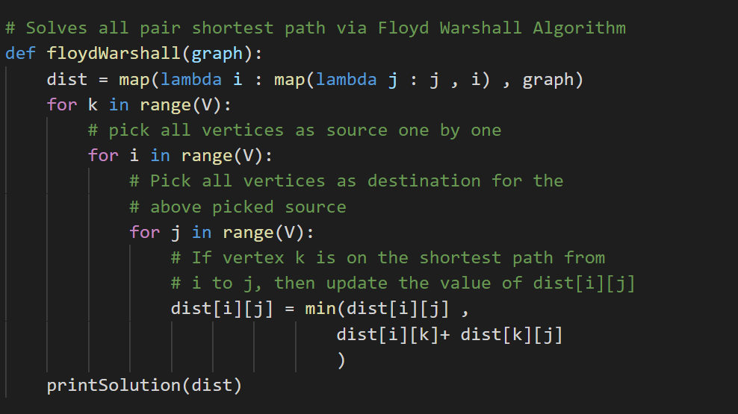
Examples of few Q-Circuits
Calculating the heuristic search algorithm...
Euclidian distance but mostly shortest distance of the coupling graph is calculated using floyd Warshall Algorithm and pseudo-code is givaen below...
Department of ECE
0

Slide 23
Conclusion
So quantum computers can overcome Morse law.
Quantum Errors are real problem and must be addressed both in Hardware as well as in the software level.
Topological behaviour can be seen in Quantum level and can be used to for Quantum Error Correction in Software level.
A* Search algorithm and Partitioning the circuits to layers
are effective methods to solve the problem.
Compared to the average results yield by IBM’s solution, improvements of 27.5% and 22.0% for gate count and circuit depth, respectively.
Department of ECE
0

Slide 24
References
Alwin Zulehner, Alexandru Paler, and Robert Wille. Efficient mapping of quantum circuits to the ibm QX architectures. In Design, Automation & Test in Europe Conference & Exhibition (DATE), 2018, pages 1135–1138. IEEE, 2018
“Quantum Mechanics, the theortical minima” by Leonard Susskind
“Surface codes: Towards practical large-scale quantum computation” https://arxiv.org/abs/1208.0928
“QISKIT Python SDK.” https://github.com/QISKit/qiskit-sdk-py.
“Tackling the Qubit Mapping Problem for NISQ-Era Quantum Devices” https://arxiv.org/pdf/1809.02573.pdf
Department of ECE
0

Slide 25
Thank You
Bhuvanesh S K
(4NM16EC026)
Department of ECE
0

